Slide 1


Mini Project - Synopsis on
“Decentralized File Storage System Using Blockchain“
Dept. of CS&E ( DATA SCIENCE)
Adichunchanagiri Institute of Technology
Chikkamagaluru - 577102
Presented By,
Chaithra G L ( 4AI22CD010 )
Nidhi H Baraker ( 4AI22CD037 )
Shreya M S ( 4AI22CD049 )
Shwetha K M (4AI22CD050 )
Under the Guidance of
Dr. Adarsh M J

Slide 2
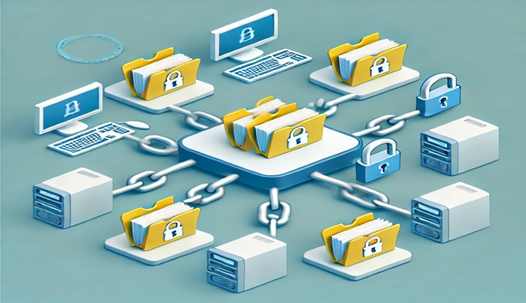
About The Project (Description)
The decentralized file storage system uses blockchain technology to safely and reliably store and manage data. Instead of relying on central servers, it spreads files across many different computers, which improves data safety and reduces the chances of losing information or getting hacked.
Key features:
Decentralization
Blockchain Integration
Data Security
Scalability
User-Friendly Interface

Slide 3
Motivation (Reasons for Choosing the Topic)
Security & Privacy: With increasing concerns over data breaches in centralized cloud storage systems, we wanted to create a solution that gives users full control over their data.
Blockchain Adoption: We wanted to explore the potential of blockchain technology in solving real-world problems, specifically in secure file storage.
Improved Data Availability: Files can be retrieved even if some nodes are offline, ensuring data is always accessible.
Decentralization: Traditional cloud storage relies on centralized providers, which can lead to data loss or censorship. A decentralized solution like this ensures greater fault tolerance and prevents control by a single authority.

Slide 4
What it means?
Blockchain : A distributed ledger technology that stores information in a secure, immutable, and decentralized manner
Decentralized System : control and decision-making are distributed across multiple independent entities or participants, rather than being held by a single authority. There is no central point of control or failure, making the system more resilient, secure, and transparent.
Centralized System : control and decision-making are concentrated in a single authority or organization. All data, operations, and control flow
through one central entity, like a company, server, or administrator

Slide 5

Cloud v/s Decentralized File Storage
Feature | Cloud Storage | Decentralized File Storage
Control | Centralized control by a single provider | Control is distributed across multiple nodes
Data Ownership | Provider has access to stored data | Users have full control and ownership of their data
Security | Provider handles encryption, but may access data | Data is encrypted by the user; only they can access it
Reliability | Single point of failure (provider’s server) | No single point of failure (data distributed across nodes)
Censorship | Provider can censor or remove data | No central authority to censor or remove data
Transparency | Limited visibility into data management | Full transparency with blockchain records
Fault Tolerance | Dependent on provider’s infrastructure | Data is redundant across multiple nodes, ensuring higher fault tolerance
Cost Structure | Pay the provider for storage services | Pay storage nodes directly (usually with cryptocurrency)

Slide 6
Problem Definition
To implement Decentralized File Storage System using Blockchain
In traditional cloud storage systems, users store their files on centralized servers controlled by companies like Google, Amazon, or Dropbox. This leads to several issues:
1.Centralized Control: The cloud provider has full control over your data, meaning they can access, modify, or even delete it without your permission.
2.Data Breaches: Since all data is stored in one central location, it becomes a target for hackers. If the provider's security is breached, your personal or sensitive information can be exposed.
3.Lack of Privacy: Cloud providers often have access to your data and can analyze or share it, violating your privacy.
4.Censorship and Downtime: Cloud providers can remove or block access to your data for various reasons, and if their servers go down, you may lose access to your files temporarily.
5.Single Point of Failure: If the centralized server fails, your data might become
unavailable or even lost.

Slide 7
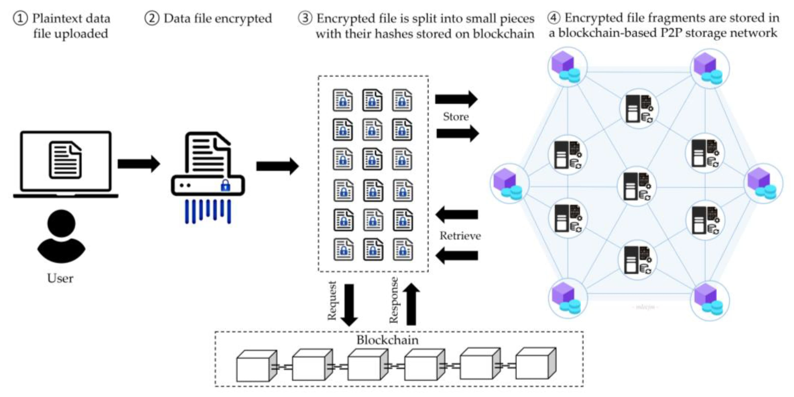
The Process

Slide 8
Tools and Technology
Frontend: HTML, CSS
Backend: Python (Flask), Web3.py for blockchain interactions
Smart Contracts: Solidity for Ethereum
Decentralized Storage: IPFS for file storage
Blockchain: Ethereum (Rinkeby or Ganache for testing)
Development Tools: Remix or Truffle for smart contract deployment, Infura for IPFS and Ethereum interactions

Slide 9
Expected Outcomes
Increased Data Security: Files will be encrypted, and only the owner has access, ensuring privacy.
Greater Control and Transparency: Users will maintain control of their data without relying on a third party, with clear records of all interactions stored on the blockchain.
Fault Tolerance: The system will provide higher reliability through data redundancy, allowing files to be recovered even if certain nodes are offline.
Scalability: As more nodes join the network, the system can scale naturally, supporting more users and larger amounts of data.
Incentivized Participation: Storage providers will be rewarded with tokens, encouraging them to offer their resources

